Slide 1
Rates and Self Determination

Slide 2
Rate Determination
Rates are developed based on three categories:
Rates determined by the Department of Developmental Services, commonly referred to State-set rates.
Negotiated Rates are determined through a review of actual operational costs that are submitted and developed directly with the regional center.
Schedule of Maximum Allowances- rates that are established by Medi-Cal for services that could or would be provided through managed care.

Slide 3
DDS Set Rates
◆ Rates are established directly with DDS once vendored by the regional center.
◆ Services include:
◆ Alternative Residential Model (ARM)
◆ Day Programs (Activity Center, Adult Development Center, Behavior
Management)
◆ Work Activity Programs
◆ Infant Development Programs
◆ In-Home Respite Services
◆ Independent Living
◆ Social Recreational
Source: https://www.dds.ca.gov/rc/vendor-provider/vendorization-process/vendor-rates/

Slide 4
Negotiated Rates
Rates are negotiated directly with the regional center.
  Must be in accordance with § 57300
  Vendors must provide costs associated with providing the services.
  Direct Service Costs (4691.10 ) These may include wages for staff who spend 75% or more
time providing direct services, payroll costs, applicable taxes,
insurances, and benefits.
Administrative Costs(4629.7) These may include salaries for
staff who do not provide direct services, facility or office
costs, repair/maintenance, training, taxes, interest, and
depreciation.
Regional Centers are required to use “median rates” as the upper limit in negotiations.
( please see the median rates)

Slide 5
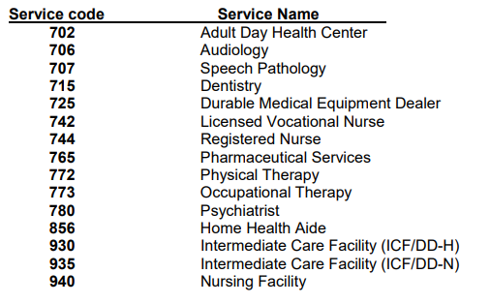
Schedule of Maximum Allowances
◆ Commonly referred to as “SMA Rates” are rates used for services that are established
by Medi-Cal and provide the same service.
◆ If a service is also provided under the Medi-Cal program, then regional center may provide no more than the rate established by Medi-Cal for the same service
Medi-Cal : https://files.medi-cal.ca.gov/Rates/RatesHome.aspx

Slide 6
Other Rates
Supported Employment Programs –
these rates are reflected in Welfare and Institutions Code 4860 (a) and (b)
(effective 1 /1/2020)
Supported Employment Group - Service code 950
the hourly rate shall be $39.57
Supported Employment Individual - Service Code 952
the hourly rate shall be $39.35

Slide 7
Tips
Use the resources outlined in the presentation to help guide negotiations when negotiating rate of pay for staff under the Self Determination Program.
Be mindful of the budget and be sure to project costs for the entire year.
Be mindful of the minimum wage for the area, both State and local ordinances.

Slide 8
Important Resources and Links
DDS Rate Process Overview: https://www.dds.ca.gov/rc/vendor-provider/vendorization-process/vendor-rates/
Rates set by DDS: https://www.dds.ca.gov/rc/vendor-provider/vendorization-process/vendor-rates/
Schedule of Maximum Allowances (SMA) https://files.medi-cal.ca.gov/Rates/RatesHome.aspx
Supported Employment Rates: WIC § 4860 https://www.dds.ca.gov/rc/vendor-provider/vendorization-process/vendor-rates/
Updated September 2021

Slide 9
Questions?

